Slide 1
Chapter 3 – Agile Software Development (Ian Somerville)

Slide 2
Content
Origin Of Agile
Agile methods
Agile development techniques
Agile project management
Scaling agile methods
Agile beyond Software Development

Slide 3


Slide 4
Challenges in Software Development
Let’s list down issues which you feel exist while doing software development using traditional ways of working

Slide 5
Challenges in Software Development
Rapid development and delivery is now the most important requirement.
Businesses operate in a fast –changing requirement and it is practically impossible to produce stable software requirements.
Software has to evolve quickly to reflect changing business needs.

Slide 6
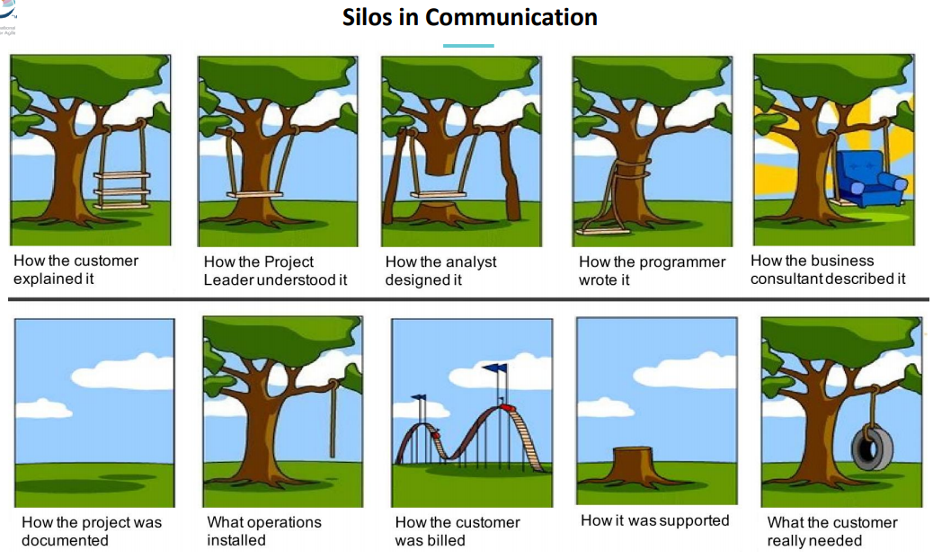
Source:https://www.silvertreesystems.com/blog/process-silos-are-killing-your-productivity/

Slide 7
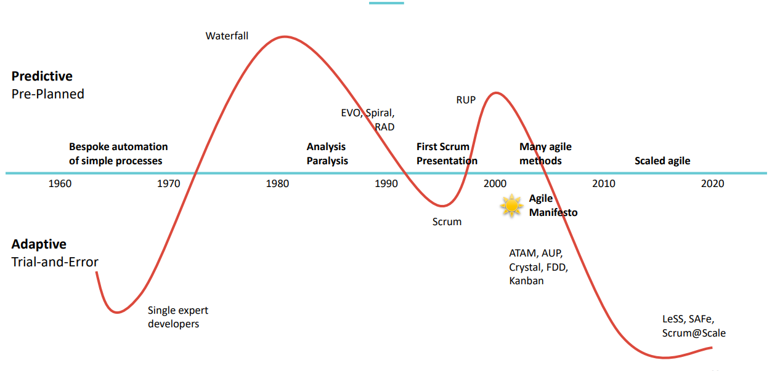
Origin of Agile

Slide 8
Agile Methods
Dissatisfaction with the overheads involved in software design methods of the 1980s and 1990s led to the creation of agile methods. These methods:
Focus on the code rather than the design
Are based on an iterative approach to software development
Are intended to deliver working software quickly and evolve this quickly to meet changing requirements.
The aim of agile methods is to reduce overheads in the software process (e.g. by limiting documentation) and to be able to respond quickly to changing requirements without excessive rework.

Slide 9
Plan-driven and agile development

Slide 10
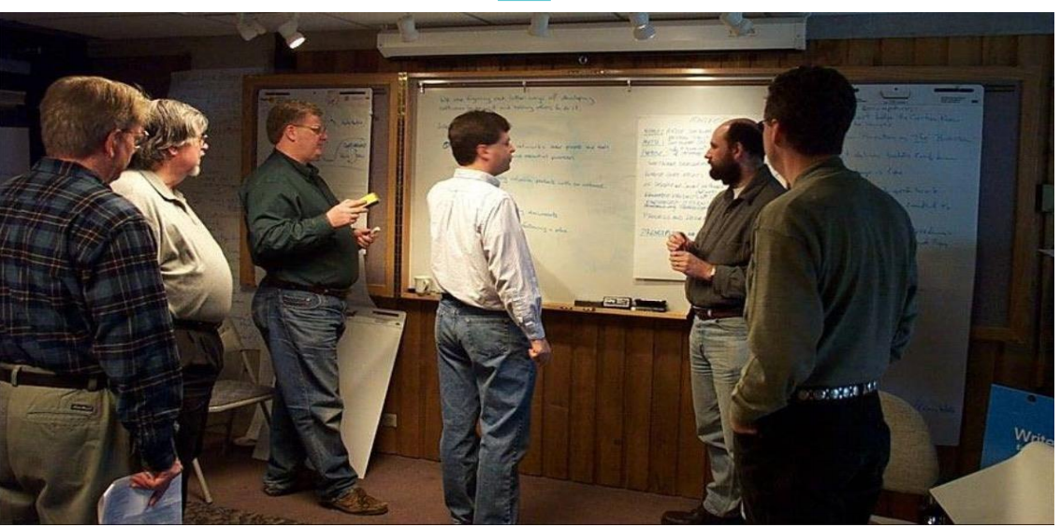
And agile was born … 2001

Slide 12
Build the Agile Manifesto:
These Value are Preferred |  | Over These Values
 | >
 | >
 | >
 | >
over processes and tools
over comprehensive documentation
Working software
Responding to change
over following a plan
Customer collaboration
over contract negotiation
Individuals and interactions

Slide 13

Agile Manifesto:
“We are uncovering better ways of developing software by doing it and helping others do it.
Through this work we have come to value:
Individuals and interactions over processes and tools
Working software over comprehensive documentation
Customer collaboration over contract negotiation
Responding to change over following a plan
That is, while there is value in the items on the right, we value the items on the left more.”

Slide 14
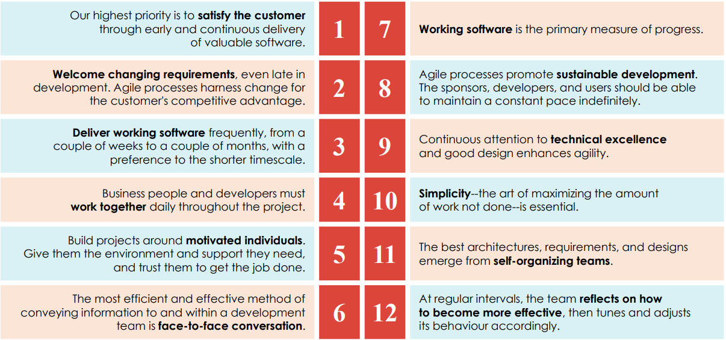
Twelve Principles of Agile

Slide 15
Agile method applicability
Product development where a software company is developing a small or medium-sized product for sale.
Virtually all software products and apps are now developed using an agile approach
Custom system development within an organization, where there is a clear commitment from the customer to become involved in the development process and where there are few external rules and regulations that affect the software.

Slide 16
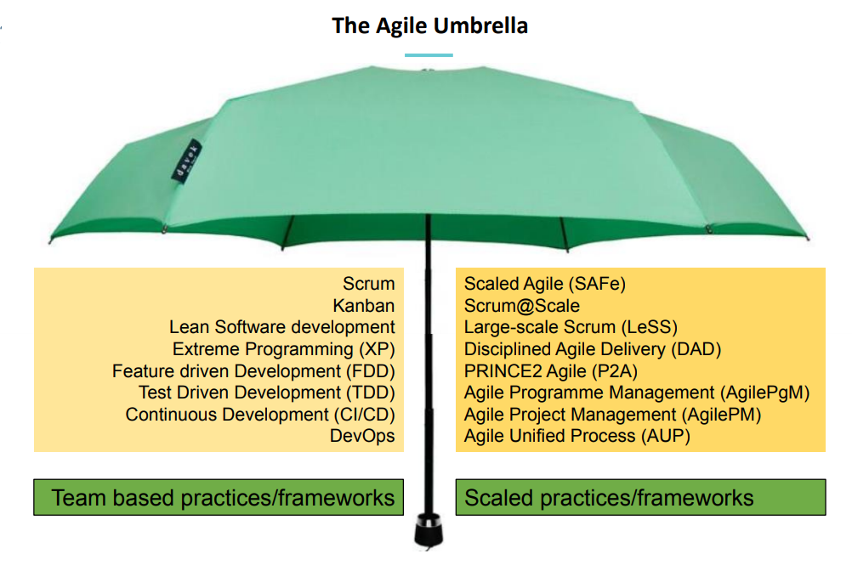

Slide 17
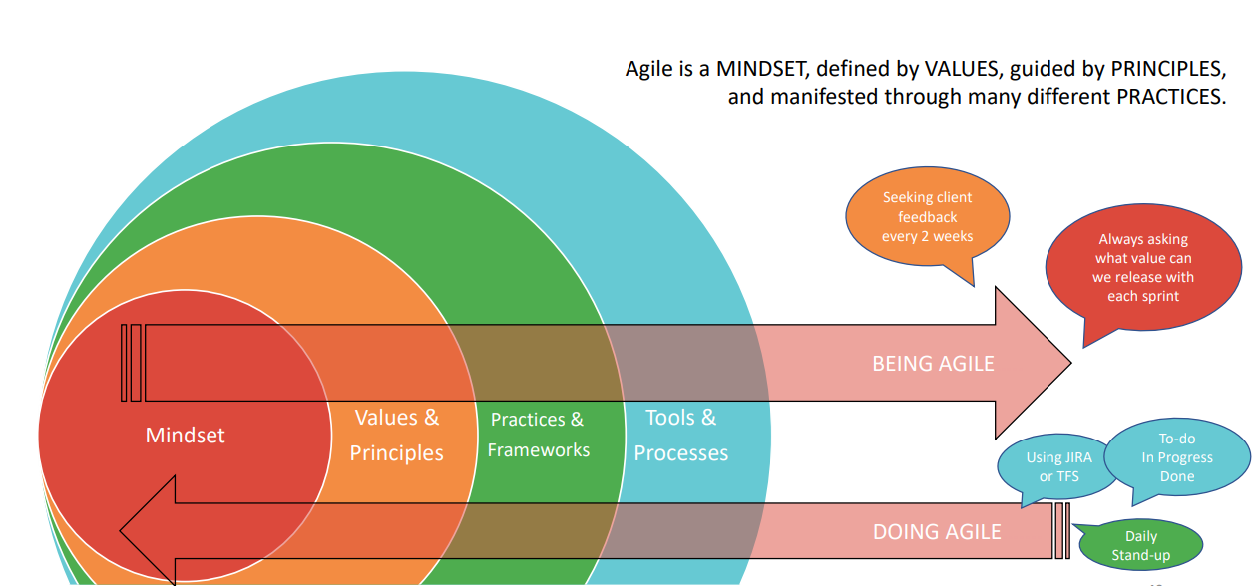
Understanding the Agile Mindset

Slide 18
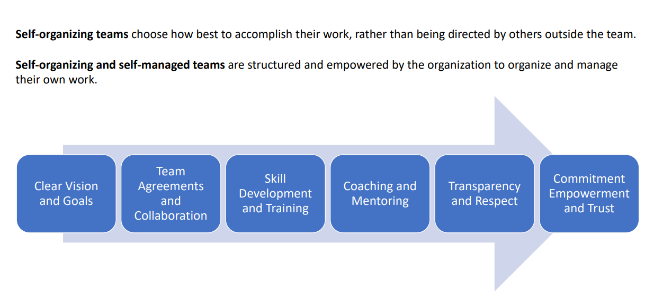
How Teams Become Self-Organizing
Book Suggestion: Harvard business review : How I learned to let my workers lead

Slide 19
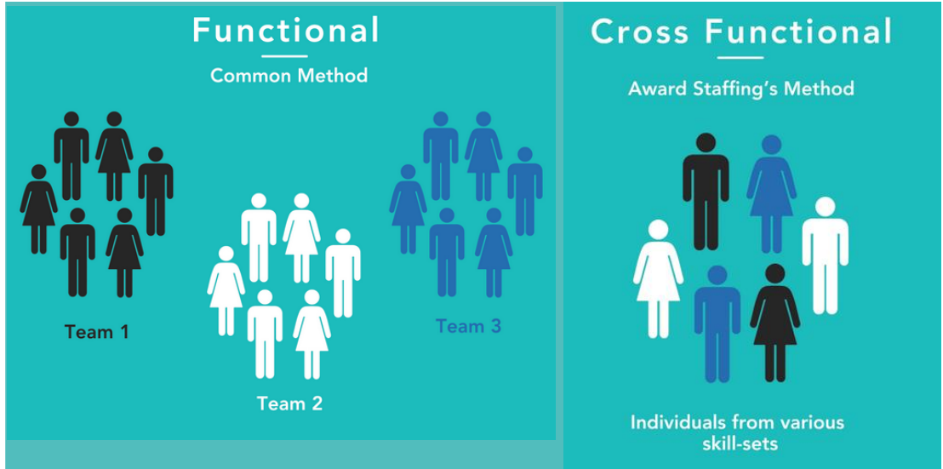
Cross-Functional Team

Slide 20
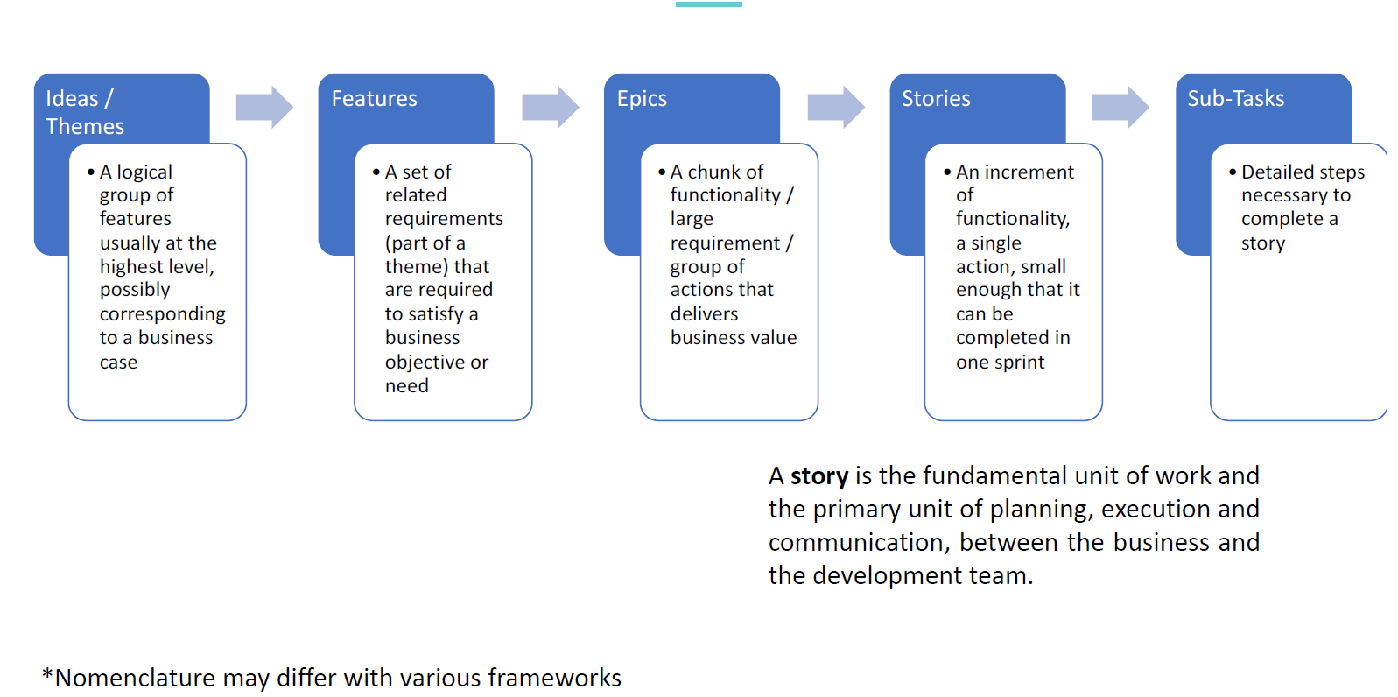
Idea of Backlog:

Slide 21
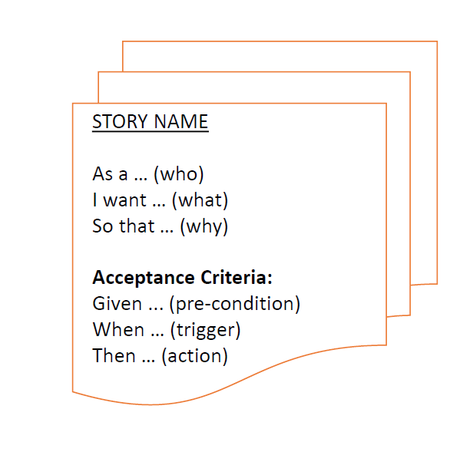
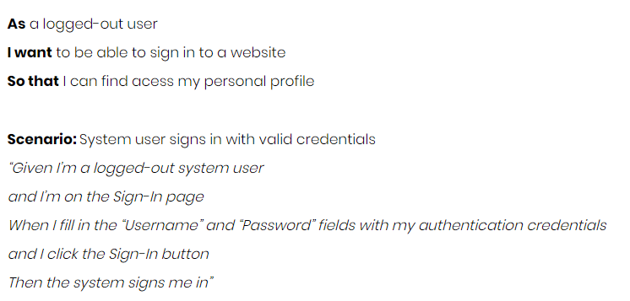
Components of User Stories:

Slide 22
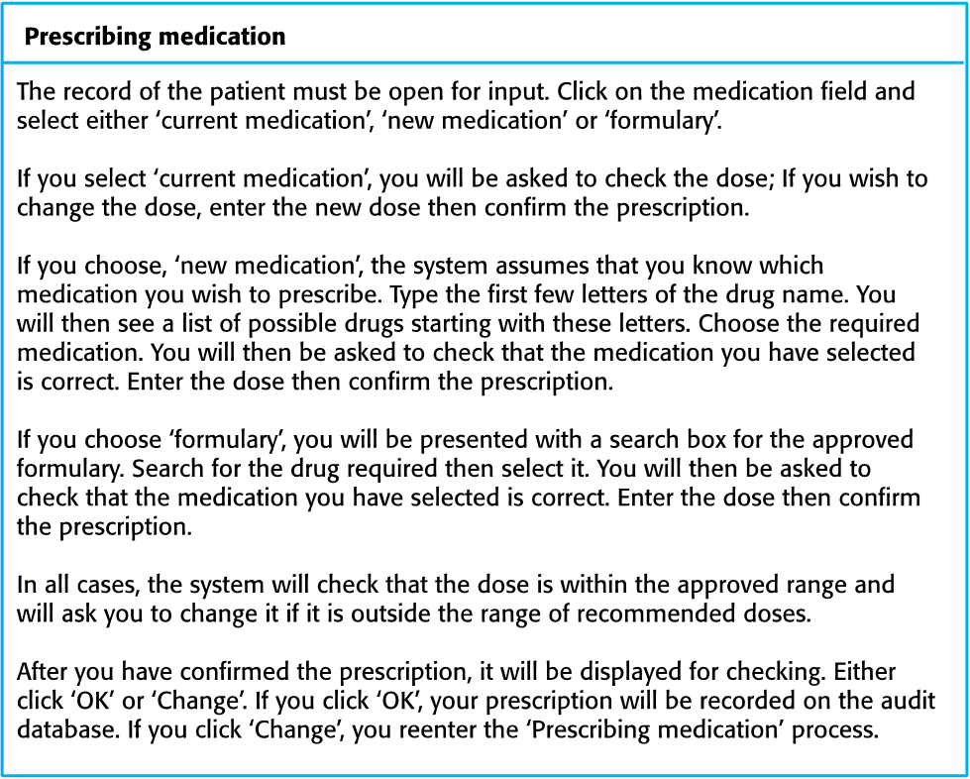
A ‘prescribing medication’ story

Slide 23
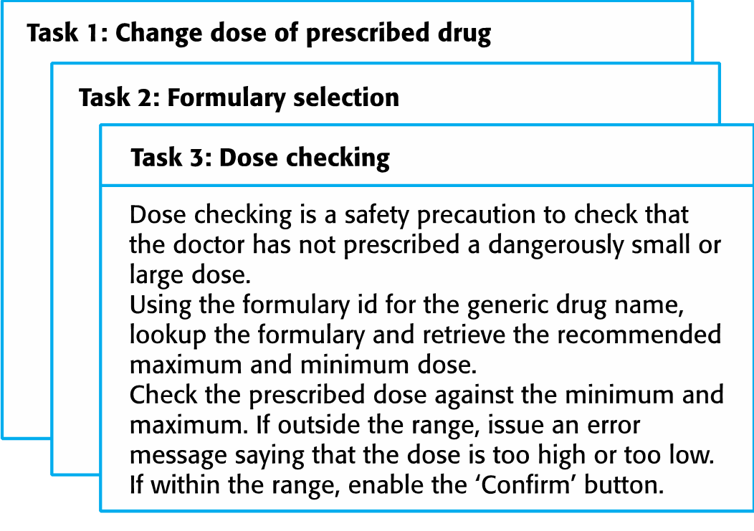
Examples of task cards for prescribing medication :

Slide 24
Agile development techniques

Slide 25
Extreme programming:
A very influential agile method, developed in the late 1990s, that introduced a range of agile development techniques.
Extreme Programming (XP) takes an ‘extreme’ approach to iterative development.
Increments are delivered to customers every 2 weeks;
All tests must be run for every build and the build is only accepted if tests run successfully
New versions may be built several times per day;

Slide 26
The extreme programming release cycle:

Slide 27
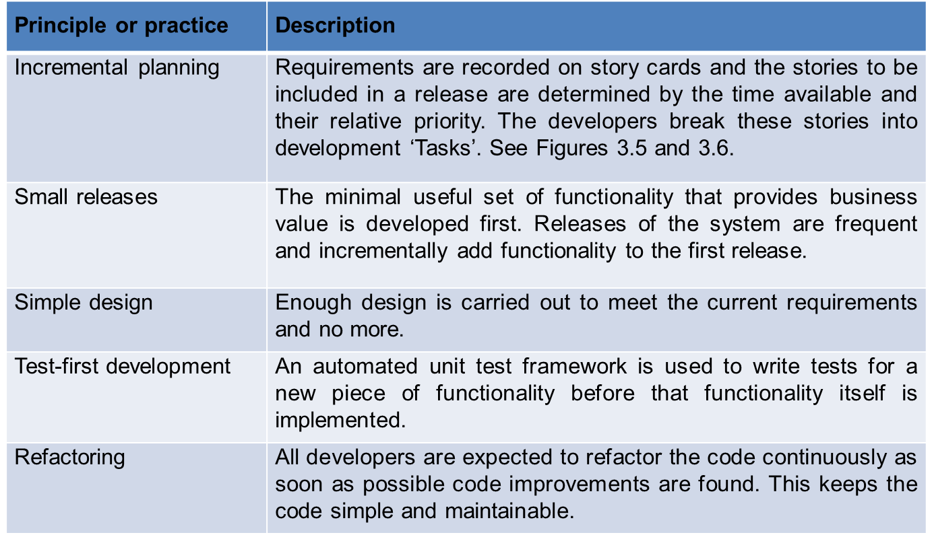
Extreme programming practices (a)

Slide 28
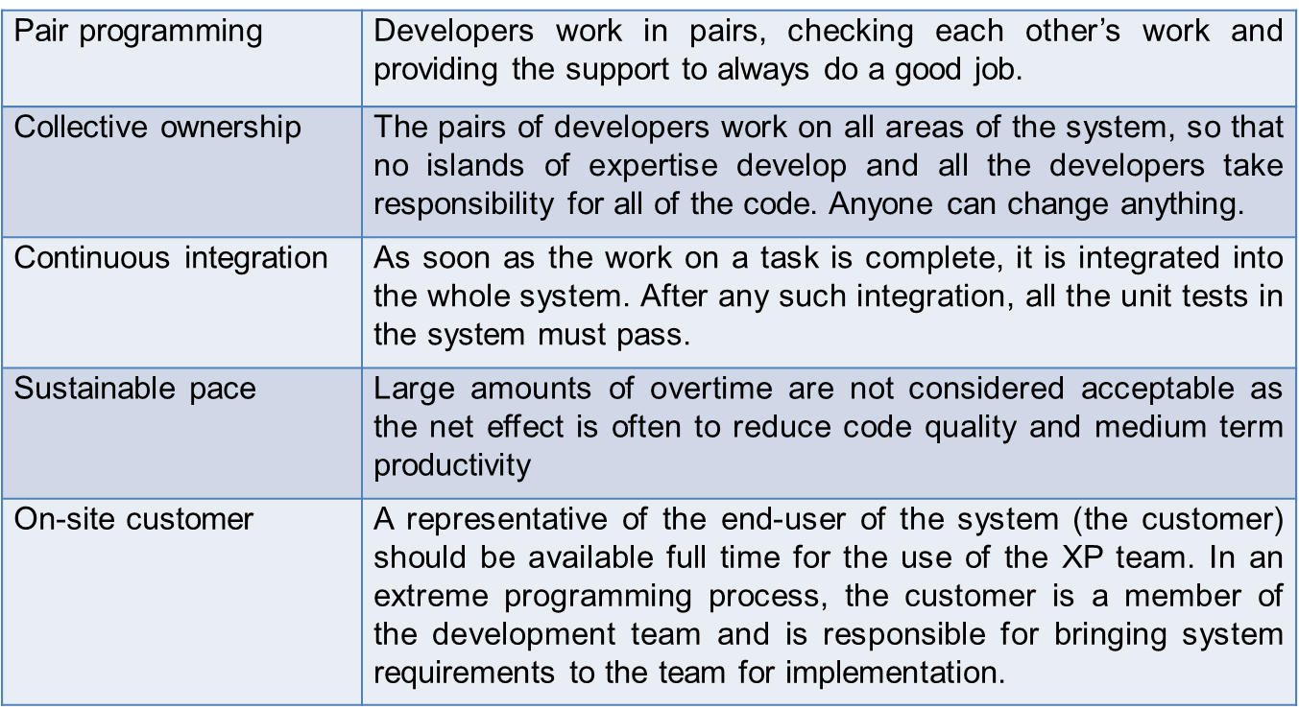
Extreme programming practices (b):

Slide 29
XP Reflects Agile Manifesto:
Incremental development is supported through small, frequent system releases.
Customer involvement means full-time customer engagement with the team.
People not process through pair programming, collective ownership and a process that avoids long working hours.
Change supported through regular system releases.
Maintaining simplicity through constant refactoring of code.

Slide 30
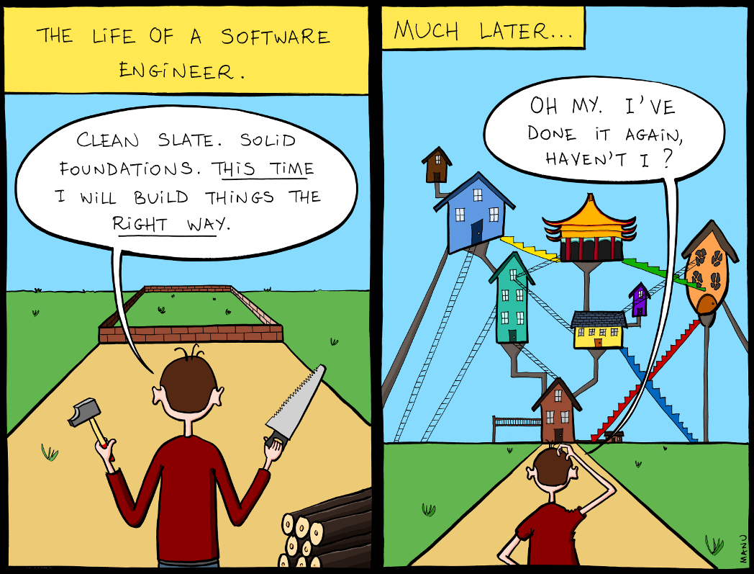
Examples of refactoring
Re-organization of a class hierarchy to remove duplicate code.
Tidying up and renaming attributes and methods to make them easier to understand.
The replacement of inline code with calls to methods that have been included in a program library.

Slide 31
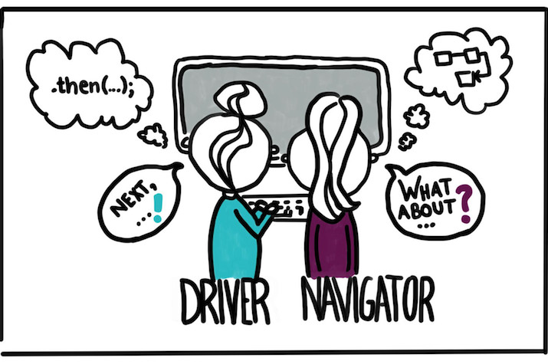
Pair programming
Pair programming involves programmers working in pairs, developing code together.
This helps develop common ownership of code and spreads knowledge across the team.
It serves as an informal review process as each line of code is looked at by more than 1 person.

Slide 32
Pair programming
In pair programming, programmers sit together at the same computer to develop the software.
Pairs are created dynamically so that all team members work with each other during the development process.
The sharing of knowledge that happens during pair programming is very important as it reduces the overall risks to a project when team members leave.

Slide 33
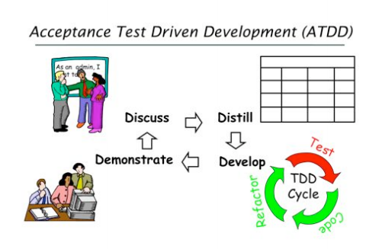
Test-first development
Testing is central to XP and XP has developed an approach where the program is tested after every change has been made.
XP testing features:
Test-first development.
Incremental test development from scenarios.
User involvement in test development and validation.

Slide 34

Test automation
Test automation means that tests are written as executable components before the task is implemented
Whenever any functionality is added to the system, the tests can be run and problems that the new code has introduced can be caught immediately.

Slide 35
Problems with test-first development
Programmers prefer programming to testing and sometimes they take short cuts when writing tests.
It difficult to judge the completeness of a set of tests. Although you may have a lot of system tests, your test set may not provide complete coverage.

Slide 36
Customer involvement
The role of the customer in the testing process is to help develop acceptance tests for the stories that are to be implemented in the next release of the system.
People adopting the customer role have limited time available and so cannot work full-time with the development team.

Slide 37
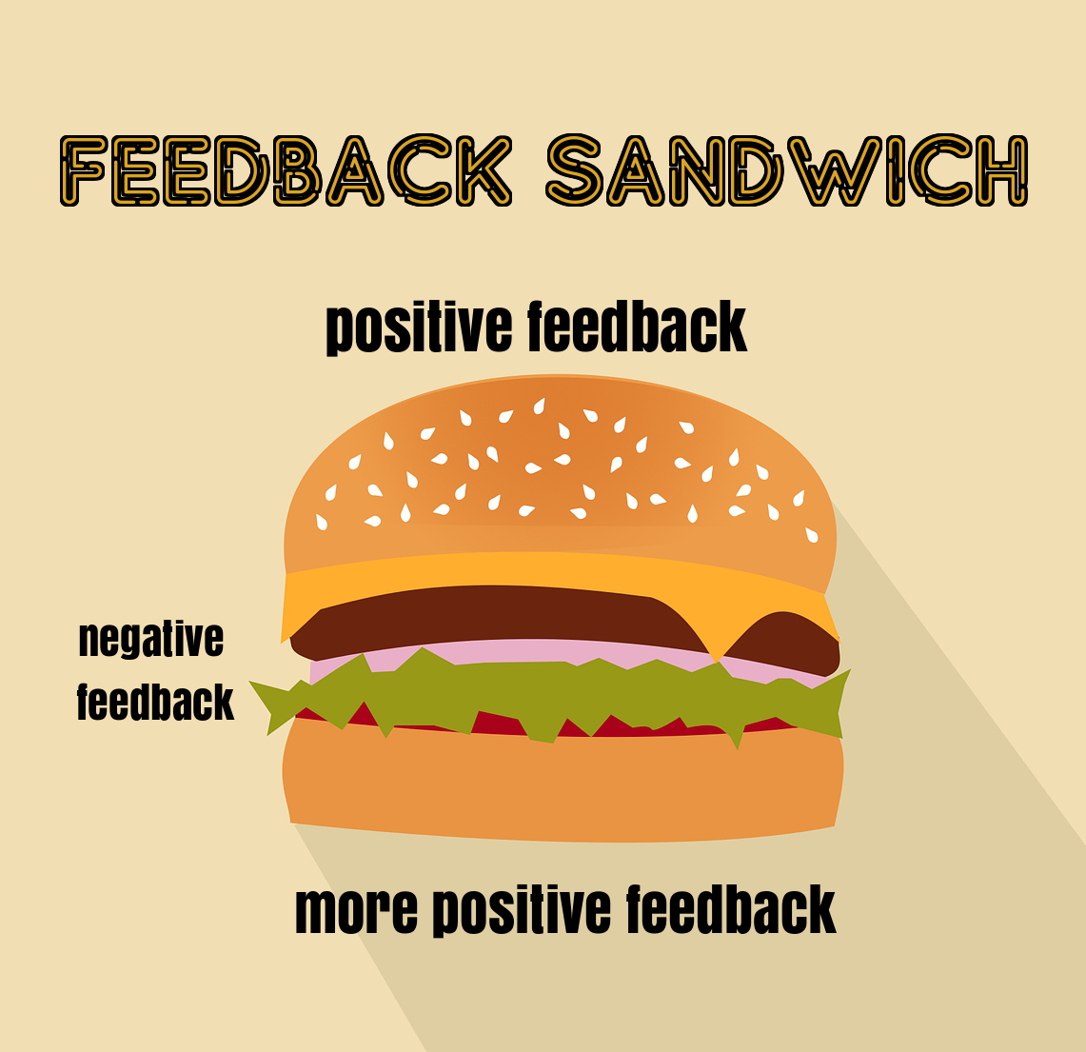
Activity

Slide 38
Course Feedback

Slide 39
Course Feedback Analysis
Real Life Example
Previous Lecture recap
Behind schedule
Leave class timely
Lecture Rapid Delivery (LOL)

Slide 40
Agile project management

Slide 41
Agile project management
The principal responsibility of software project managers is to:
Manage the project
Delivered on time and within the planned budget for the project.

Slide 42
Scrum
Scrum is an agile method that focuses on managing iterative development .
There are three phases in Scrum.
The initial phase is an outline planning phase where you establish the general objectives for the project.
This is followed by a series of sprint cycles, where each cycle develops an increment of the system.
The project closure phase wraps up the project, and assesses the lessons learned from the project.

Slide 43
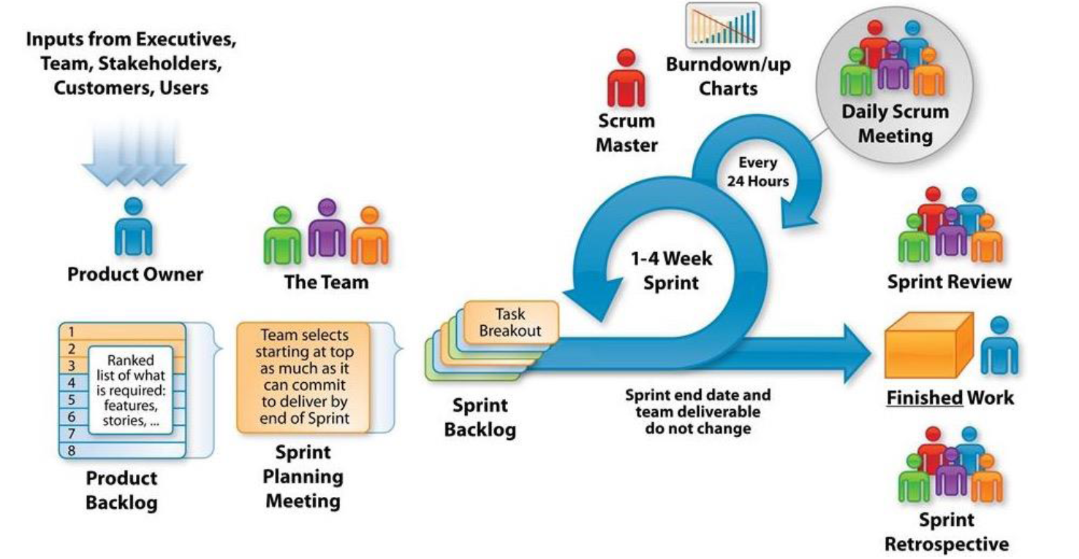
Scrum

Slide 44
Scrum Terminologies
Scrum term | Definition
Development team | A self-organizing group of software developers, which should be no more than 7 people.
Potentially shippable product increment | The software increment that is delivered from a sprint. The idea is that this should be ‘potentially shippable’ which means that it is in a finished state and no further work.
Product backlog | This is a list of ‘to do’ items which the Scrum team must tackle. They may be feature definitions for the software, software requirements, user stories.
Sprint | A development iteration. Sprints are usually 2-4 weeks long.
Velocity | An estimate of how much product backlog effort that a team can cover in a single sprint. Understanding a team’s velocity helps them estimate what can be covered in a sprint and provides a basis for measuring improving performance.

Slide 45
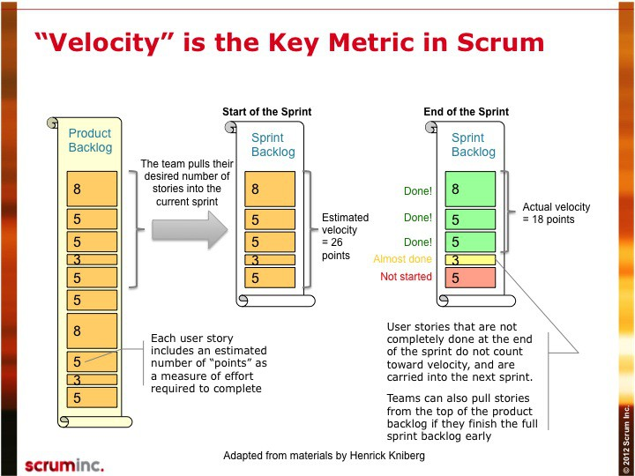

Slide 46
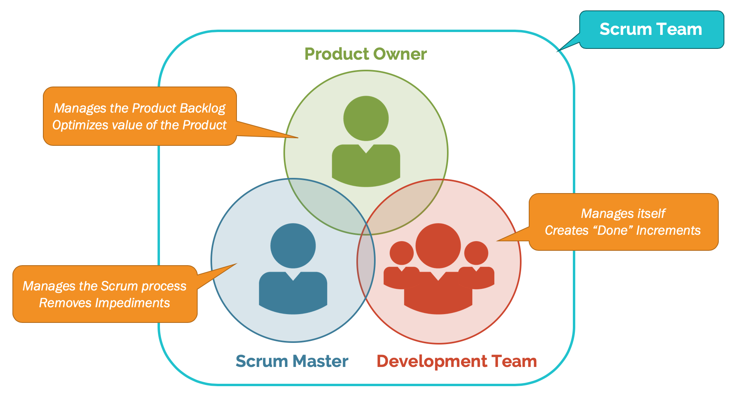
Scrum Roles

Slide 47
Roles
Product owner
Identify product features or requirements
Prioritize these for development
Ensure that the project continues to meet critical business needs
The Product Owner can be a customer.
Scrum Master
Responsible for interfacing with the rest of the company
Ensuring that the Scrum team is not diverted by outside interference.
Scrum Master should not be thought of as a project manager.
To protect the development team from external distractions

Slide 48
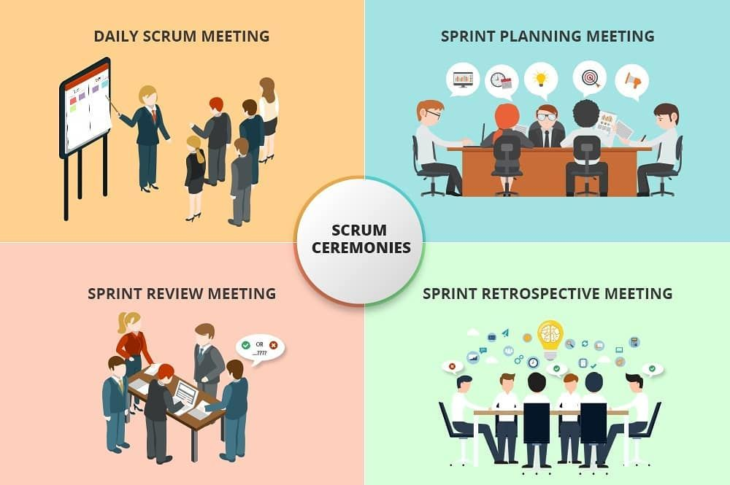
Scrum Ceremonies

Slide 49
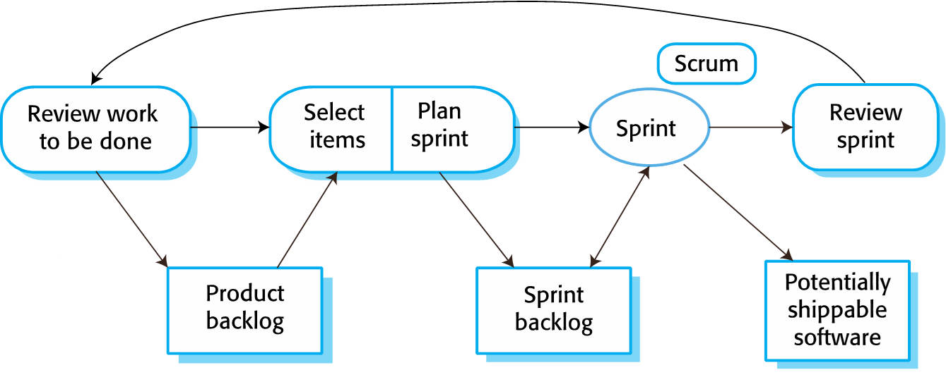
Scrum sprint cycle

Slide 50
Scrum benefits
The product is broken down into a set of manageable and understandable chunks.
Unstable requirements do not hold up progress.
The whole team have visibility of everything and consequently team communication is improved.
Customers see on-time delivery of increments and gain feedback on how the product works.
Trust between customers and developers is established and a positive culture is created in which everyone expects the project to succeed.

Slide 51
Distributed Scrum

Slide 52
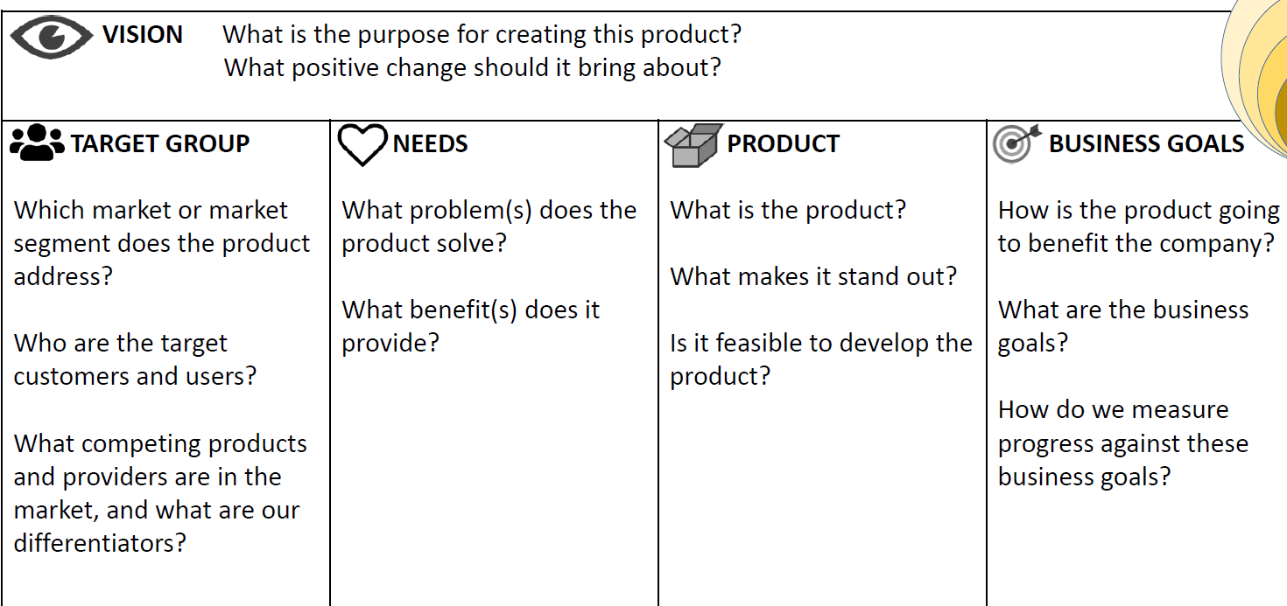
Project Instructions

Slide 53
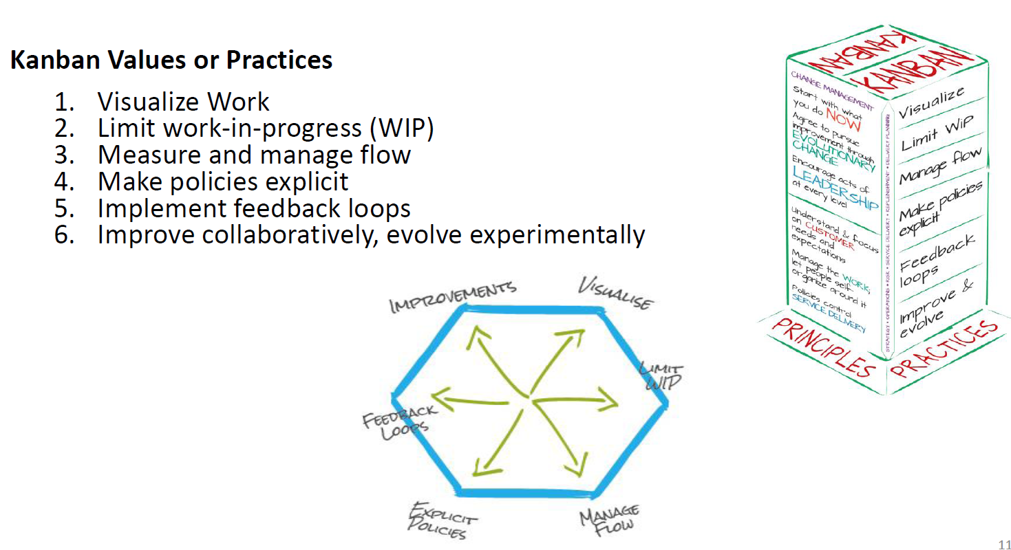
Kanban Values And Principles:

Slide 54
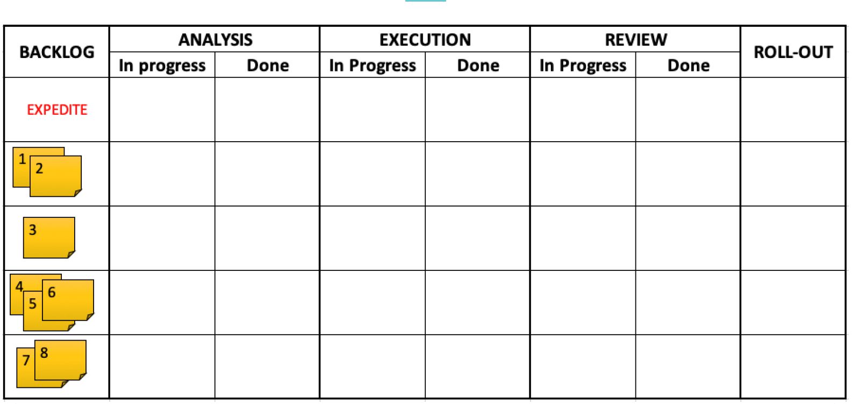
Visualize Work

Slide 55
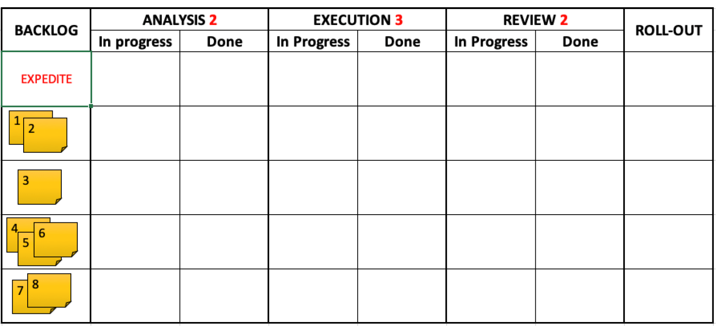
Limit Work in Progress

Slide 56
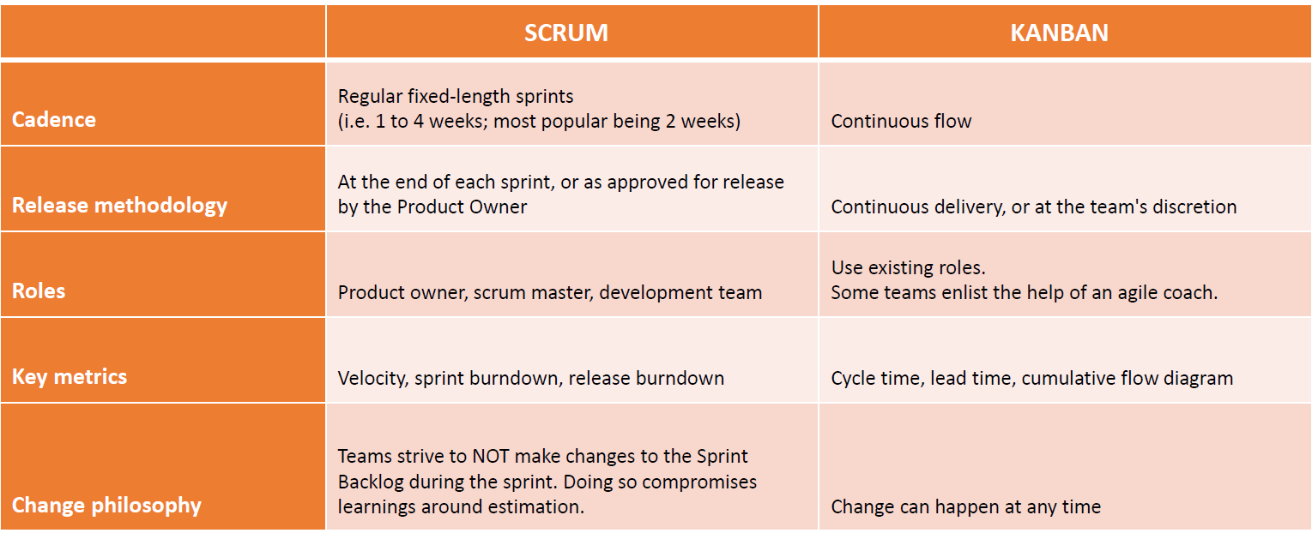
Scrum VS Kanban

Slide 57

Agile Beyond Software Development

Slide 58
Scaling Agile Methods

Slide 59
Scaling Agile Methods:
Successful for small and medium sized projects with small co-located team.
The success of these methods comes because of improved communications.
Scaling up agile methods involves to cope with larger, longer projects with distributed teams.

Slide 60
Scaling out and scaling up
Scaling up’ is concerned with using agile methods for developing large software systems with large teams.
‘Scaling out’ is concerned with how agile methods can be introduced across a large organization with many years of software development experience.

Slide 61
Practical problems with agile methods
Contractual issues
Agile methods and software maintenance
Small Co-Located Teams

Slide 62
Agile Maintenance:
Key problems are:
Lack of product documentation
Keeping customers involved in the development process
Maintaining the continuity of the development team
Agile development relies on the development team knowing and understanding what has to be done.
For long-lifetime systems, this is a real problem as the original developers will not always work on the system.

Slide 63
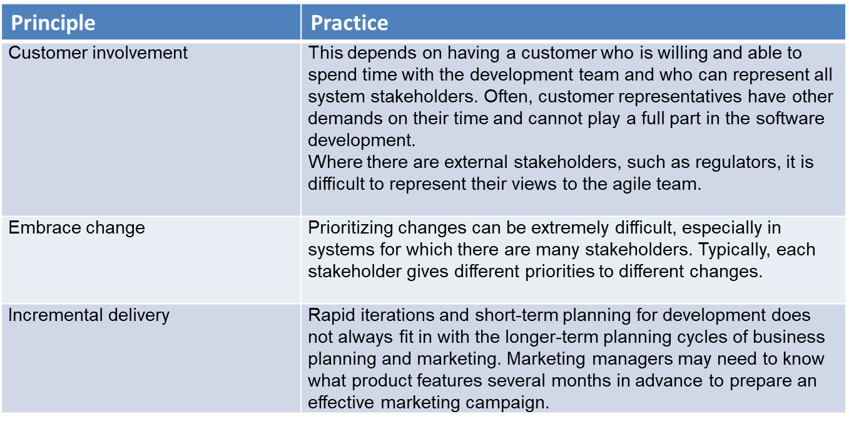
Agile principles and organizational practice

Slide 64
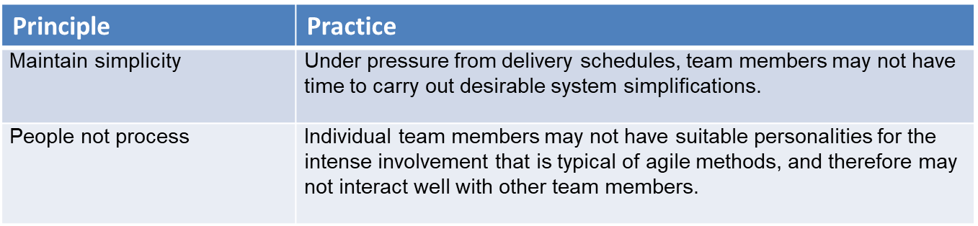
Continue…

Slide 65
System issues:
How large is the system being developed?
Agile methods are most effective a relatively small co-located team who can communicate informally.
What type of system is being developed?
Systems that require a lot of analysis before implementation need a fairly detailed design to carry out this analysis.
What is the expected system lifetime?
Long-lifetime systems require documentation to communicate the intentions of the system developers to the support team.
Is the system subject to external regulation?
If a system is regulated you will probably be required to produce detailed documentation as part of the system safety case.

Slide 66
People and teams:
How good are the designers and programmers in the development team?
It is sometimes argued that agile methods require higher skill levels than plan-based approaches in which programmers simply translate a detailed design into code.
How is the development team organized?
Design documents may be required if the team is distributed.

Slide 67
Scaling up to large systems:
A completely incremental approach to requirements engineering is impossible.
There cannot be a single product owner or customer representative.
For large systems development, it is not possible to focus only on the code of the system.
Cross-team communication mechanisms have to be designed and used.
Continuous integration is practically impossible. However, it is essential to maintain frequent system builds and regular releases of the system.

Slide 68
Agile methods across organizations:
Project managers who do not have experience of agile methods may be reluctant to accept the risk of a new approach.
Large organizations often have quality procedures and standards that all projects are expected to follow and, because of their bureaucratic nature, these are likely to be incompatible with agile methods.
Agile methods seem to work best when team members have a relatively high skill level. However, within large organizations, there are likely to be a wide range of skills and abilities.
There may be cultural resistance to agile methods, especially in those organizations that have a long history of using conventional systems engineering processes.

Slide 69
END

